Slide 1
A Primer on Machine Learning
From a Novice Machine Learnerer
Supporting files available at https://github.com/jaymztheking/Machine_Learning_Primer

Slide 2
Goals for This Presentation
Introduce basic concepts of Machine Learning
Gauge the meetup group’s present overall knowledge and interests
Identify possible future topics for discussion

Slide 3
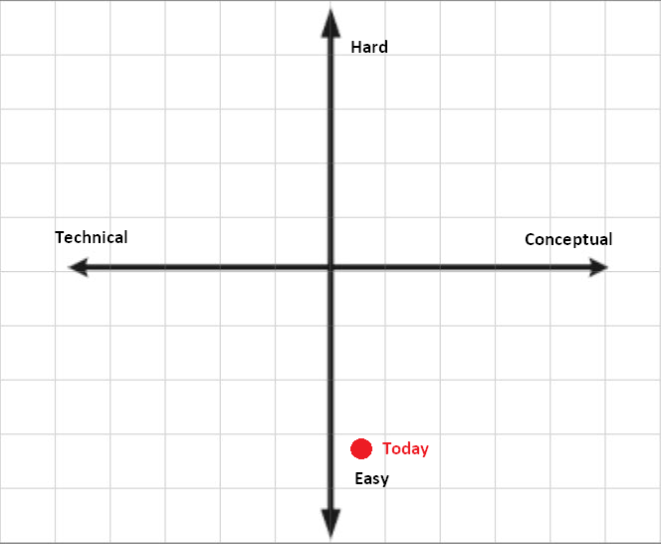
Where should we aim?

Slide 4
Who Am I?
Got Bachelor’s Degree in Applied Statistics from Northern Colorado (go Bears!)
Been in Business Intelligence for 7 years. Primarily working in Higher Ed industry
3 years ago discovered Machine Learning and “Data Science”
Not an expert by any means. Just a passionate hobbyist starting out.

Slide 5
What is Machine Learning?
Machine Learning is teaching computers to adaptively perform tasks better over time through data and statistics instead of explicit programming
Most common tasks are to predict a value (regression) or classify data (classification)
Can be mixed in with explicit programming tasks

Slide 6
Real World Examples of
Machine Learning
Regression
Netflix (estimate 0.0 to 5.0 movie rating)
Zillow (estimate home’s value)
Classification
Spam Filter (classify emails as spam/not spam)
Facebook face tagging (find what part of picture is a face)

Slide 7
How does this all work?
Machine learning can almost always be boiled down to solving an optimization problem ←Huge personal revelation
Use algorithms to minimize variance
In supervised learning, you want to minimize difference between y and f(x)
In unsupervised learning, you want to minimize variance/distance between similiarly grouped data

Slide 8
Most Elementary Example
A James-oriented Netflix rating system
One independent variable: Number of explosions in a film
One dependent variable: James’ rating of film
Model: linear regression
Optimization method: gradient descent

Slide 9
Overly Simplified Summary of Linear Regression
Plot actual data points on scatter plot
Find some line of form y = mx +b that “fits” the data
Calculate difference between line and actual points and square it.
Sum the squares
Continue adjusting m and b until the value in step 4 is minimized

Slide 10
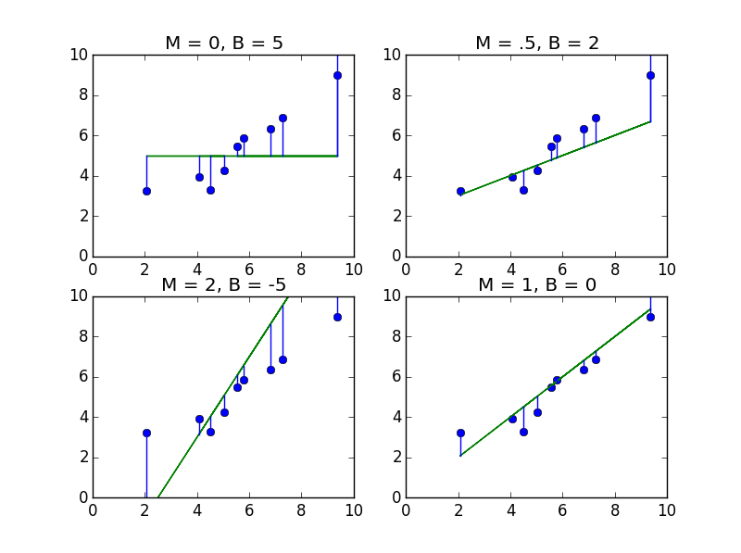
Examples of Line Fitting
(display_linefit_graphic.py)
Sum of Squares=
63.091
Sum of Squares=
63.238
Sum of Squares=
26.817
Sum of Squares=
6.012 (winner)

Slide 11
How do we determine the best parameters?
Today, gradient descent algorithm
Essentially, you plot m and b on a x-y axis and let your z axis be your sum of squares. Then you find the derivative at that point, multiply by -1 and therefore “move” the point in the opposite direction of steepness.
Pros - scales well with increased dimensions, easily adapts to data streams, fun
Cons - little bit slower for very simple, low dimension problems. Doesn’t guarantee optimal solution

Slide 12
Animated Example of Gradient Descent
(gradient_descent_button.py)
Initial Assumptions:
Graph is (X-5)^2
first derivative of said graph is 2X - 10.
First point is 8
Learning rate “g” is .1
Equation:
newA = oldA - g*(first derivative at point oldA)
newA = 8 - (.1)*(2*(8) - 10) = 8 - (.1)(6) = 8 - .6 = 7.4
Rinse and repeat until convergence (hopefully)

Slide 13




Applying Gradient Descent to Example
(gradient_descent_movie.py)
Cost function =
Gradient of m = =
Gradient of b = =
Everything else chosen semi-arbitrarily

Slide 14

Tips for Gradient Descent
Choose a learning rate that converges rather than diverges
Be wary of local minima in your cost function
Decide when convergence is good enough
Scale your features if necessary
Apply regularization/penalty to avoid “overfitting”. Cost function +

Slide 15

Expanding Linear Regression to Matrix Land/Prepping for SciKit
We can rewrite our linear regression model of mx + b as mx₁ + bx₀, then again as θ₁x₁ + θ₀x₀
Further extending this we can rewrite it as:

Slide 16
Expanding Linear Regression to Matrix Land/Prepping for SciKit (cont.)
Cost function becomes y - Θ^{T}x where Θ is a matrix of weights (think [m b]) and x is a matrix of indepent variable values
Scikit-learn and other Python libraries demand you input variables as an array, so think “matrix land”.
Also get in habit of remembering to include X₀ (usually 1).

Slide 17
Do It Faster! (scikit_gradient_descent.py)
We can replicate this gradient descent procedure with a LOT less code using sci-kit learn
First we convert the X variable to matrix form (e.g [x 1])
Then we create an SGDRegressor object (since this is a regression problem)
Set regressor params to our liking
Run “fit” function, then “predict” function

Slide 18
Where Do We Go From Here?
Different Models Neural Networks Random Forests/Decision Trees Support Vector Machines Tech Deeper dive into scikit-learn Spark’s MLLib OpenCV/Computer Vision Cloud EC2 | Applications What regression problems could we solve? What classifier problems could we solve? What data can we play with? Demos Machine Learning implementations the group as done Ideas for interesting projects

